Slide 1

DIABETES PREDICTION USING MACHINE LEARNING TECHNIQUES Final year project Review phase - 1 Batch – (2019-2023) Group Members : Abhay Kumar, Sungjemkaba Reg_no : 2019105194, 2019105219 12-Dec-2022
Department of Computer Science and Engineering
National Institute of Technology Nagaland

Slide 2
Contents
Aim and objective
Motivation
Application
State of the art
Research gap
Proposed model
Work done so far
Result analysis
Conclusion
Future line of study
Reference

Slide 3
Aim & objective
Main aim is to create a model using machine learning which will predict diabetes with higher accuracy.

Slide 4
Motivation
According to International diabetes federation (IDF) currently 537 million people are suffering from diabetes and this figure is expected to reach 643 million by 2030.
Diabetes can be controlled if it is predicted earlier.
It has been suggested that detecting diabetes at an early stage may aid diabetic patients in diminishing their chance of developing other illnesses such as heart disease, neuropathy, or retinopathy in the future.
To achieve this task, a model is required for early prediction of Diabetes in the human body, which can predict with higher accuracy based on various Machine Learning Techniques.

Slide 5
Application
Diabetes prediction model can be used in the medical field.
As a small device a person can keep it with themselves at home and do a regular checkup like :
Glucose level
Blood pressure
Skin thickness
BMI index

Slide 6
State of the art
Sl. No. | Title of the paper | Name of the Authors | Year of Publication | Name of the Journal | Purpose | Model used
1. | A Novel Diabetes Healthcare Disease Prediction Framework Using Machine Learning Techniques | Shubham joshi, Ali Rizwan, Bas-ant Tiwari | 2022 | Journal of Healthcare Engineering. (Hindawi) | They performed the review of the literature on machine learning and suggested an intelligent system for finding the diabetes. | Decision tree, Random Forest, SVM, with having 73% accuracy.
2. | Prediction of Type 2 Diabetes using Machine Learning Classification Methods | Neha prema tigga, shruti garg. | 2020 | Journal of Procedia computer science. (Elsevier) | Type 2 diabetes prediction using random forest as well as KNN algorithm. | Random forest , KNN.
3. | AI-based smart prediction of clinical disease using random forest classifier and Naive Bayes | V.Jackins , Svindal , M.kalliappan , Mi young lee. | 2020 | The Journal of Supercomputing. (Springer) | To discover a model for the diagnosis of diabetes, coronary heart disease, and cancer among the available data. | Random forest, Naïve Bayes.

Slide 7
Research Gap
Using the KNN , Random forest classifier and 5-fold cross validation method ,by removing the noise they get an accuracy of 73.82%.
Using the Naive Bayesian classifier and partition with the help of 10 fold cross validation The performance was evaluated using the measures of the accuracy, the precision, recall, and the F-measure. The highest accuracy was obtained by the Naive Bayes, which reached 76.30% .

Slide 8
Proposed Model
Min-Max Scaler
Classification algorithm such as SVM(Support Vector Machine),
Decision Tree
DATA
PREPROCESS DATA
Performance analysis
Replacing Missing value
Accuracy and F-Score
Representation of the work flow of the model

Slide 9
Diabetes dataset
Total no of hypotheses in PIMA diabetes dataset is 768, out of which 268 is predicting it to be 1(having diabetes) rest 0(not having diabetes), so the dataset is imbalance that’s why balancing of dataset is required.
Graph representing the diabetes dataset.

Slide 10
Data pre-processing
Table representing the null value attribute
Out of 768 hypothesis column of some attribute contain 0 value.
That particular attribute value has been replaced with the mean of that attribute.
Total no of rows | 768
Pregnancies | 111
Glucose | 5
Blood pressure | 35
Skin thickness | 227
Insulin | 374
BMI | 11
Diabetes pedigree function | 0
Age | 0

Slide 11
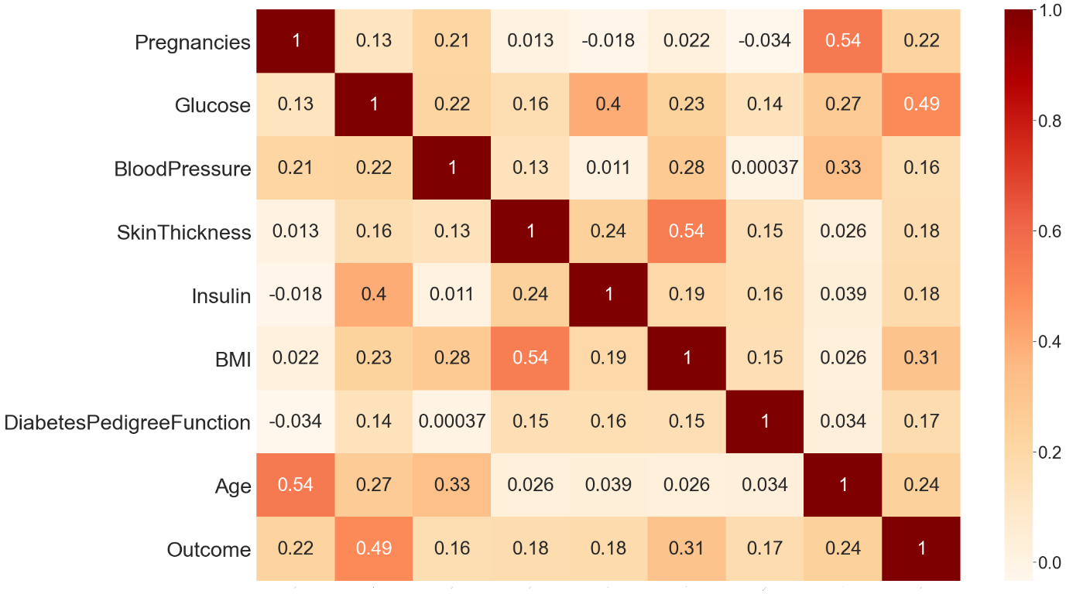
Correlation
Table Representing Correlation between different attribute and class level value.

Slide 12
Correlation contd.
A statistical measure called correlation shows how much two or more variables fluctuate in connection to one another.
When two variables rise or decrease simultaneously, there is a positive correlation, when there is a negative correlation, one variable increases as the other falls.
On the basis of that we will decide which attribute has the higher effect on the output data.
The correlation between Blood Pressure and output is minimum i.e (0.16) and that of output and glucose is maximum i.e (0.49).

Slide 13
Balancing the dataset
Dataset will be balanced using oversampling, under sampling.
In oversampling we have only 268 samples of 1 class level value , so the dataset have been randomly selected and made it to 500. Now the dataset is balanced.
In under sampling we have only 268 samples of 1 class level value so only 268 samples have been selected of class level 0 value in order to balance the dataset.

Slide 14
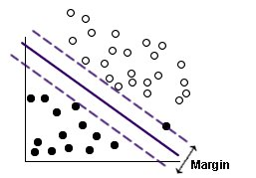
SVM
Support Vector Machine (SVM) is a relatively simple Supervised Machine Learning Algorithm used for classification / regression.
SVM finds a hyper-plane that creates a boundary between the types of data. In 2-dimensional space, this hyper-plane is nothing but a line.
Transformation in N-dimensional space, where N is the number of features/attributes in the data.
https://www.ibm.com/docs/en/SS3RA7_sub/modeler_mainhelp_client_ddita/clementine/images/svm_improved.jpg
Diagram representing SVM classification

Slide 15
Decision Tree
The most effective and well-liked technique for categorization and prediction is the decision tree. A decision tree is a type of tree structure that resembles a flowchart, where each internal node represents a test on an attribute, each branch a test result, and each leaf node (terminal node) a class label.
Decision trees classify instances by ordering them from the root of the tree to a leaf node, which then indicates the instance's categorization.
Decision tree draw the hyper rectangles in input space to solve the problem.

Slide 16
Accuracy and F1 score

Slide 17
Result analysis
Using the SVM classifier the accuracy gain on the training data set is 74% and on testing data is 76%.
Using the SVM classifier the f1 score for class level 0 is 73% and that of class level 1 is 77 %
Using the Decision tree classifier the accuracy gain on training dataset is 85% and on testing data set is 94%.
Using the Decision tree classifier the f1 score for the class level 0 is 85% and for class level 1 also 85% which is quite good.

Slide 18
Work done so far
Data pre-processing has been done by replacing the null as well as missing value with the mean of that particular attribute column.
Normalise the dataset by using the standard scaler method.
Finding the correlation between the attribute value pair.
Feature extraction using the SVM model.
Getting the accuracy , f1 score of the model.

Slide 19
Conclusion
We have concluded that f1 score plays a very crucial role in the prediction if the dataset is imbalance.
Using Decision tree classifier and pre-processing the data, we get an accuracy of 94% with having higher value of f1 score for both the classes 0(not having diabetic) and 1(having diabetic).

Slide 20
Future line of study
Increasing the accuracy of the model using neural network.
Comparative analysis with existing model.
Analysing the running time of algorithm.

Slide 21
References
[1] Shubham Joshi, Ali Rizwan , Basant Tiwari; A Novel Diabetes Healthcare Disease Prediction Framework Using Machine Learning Techniques; Journal of Healthcare engineering; vol. 2022, page (1-10), 2022.
[2] Neha prerna tigga , shruti garg; Prediction of Type 2 Diabetes using Machine Learning Classification Methods; Jounal of procedia computer science; vol. 167 ,page (706-716),2020.
[3] V. Jackins, S. Vimal, M. Kaliappan ,M.Y. Lee ;AI-based smart prediction of clinical disease using random forest classifier and Naive Bayes; Journal of Supercomputing; vol. 77,page (5198–5219), 2021.
[4] Ionnis kavakiotis, Olga Tsave,Athanasios Salifoglou; Machine Learning and Data Mining Methods in Diabetes Research; computational and structural biotechnology journal;vol. 15 , page (104-116),2020.
[5] Aishwarya Majumdar,Dr. V. vaidehi; Diabetes prediction using machine learning algorithm; International conference on recent trends in advanced computing; vol.165,page (192-199),2019.
Thank you

